Slide 1
Translation invariance
Translation equivariance
⍺-subunit
Output
Hemoglobin
Input

Slide 2
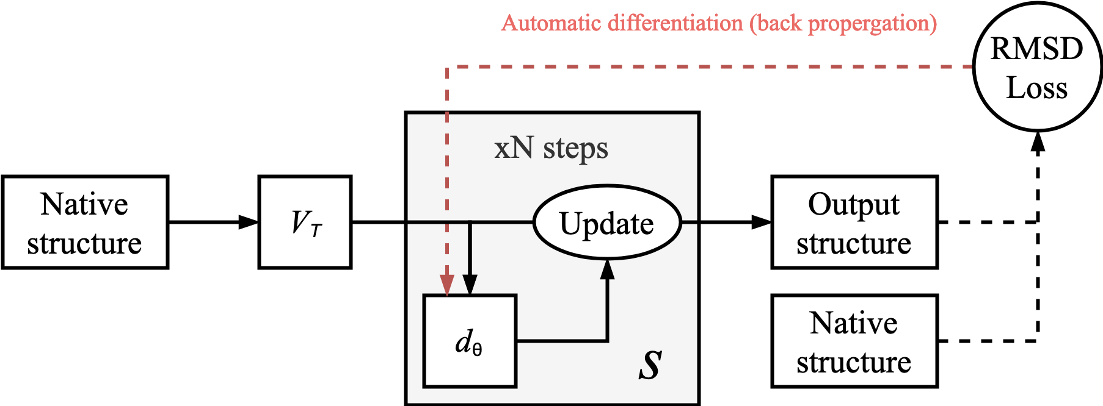
x^{t}

Slide 3
RMSD Loss
Training Time
Energy
Energy
Energy
Distance
Distance
Distance
N
N
Ca
Ca
Ca
N

Slide 4
X_{a}
M_{ab}
X_{b}

